Slide 1


Statistic
Lecture 10
Dr. Nada Abdullah Rasheed
Assist prof. / Computer Science

Slide 2
Syllabus Content
Subject | Lec. No.
Making Inferences about Regression Equations and Coefficients | 3

Slide 3
Regression
Homework Questions
1. What is the linear regression line (model)?
2. Describe what information is conveyed by the slope coefficient.
3. Describe what information is conveyed by the intercept coefficient.
4. What is the generic form of the linear regression model?

Slide 4
5. Assume you have a perfect linear relationship between variables X and Y and the relationship has a slope of 2.5. By how many units does Y change if X changes by 1 Unit? If X changes by 3 units? If X changes by 8 units?
6. What information is provided by the standard error of the estimate? What measure of variability is the standard error of the estimate similar to?

Slide 5
7. Use the following to answer the questions below. A researcher collected data on variables X any Y from each of ten subjects. The data for each of these ten subjects are below, as are the summary statistics and Pearson correlation between the two variables:

Slide 6
i | X | Y
A | 10 | 0
B | 9 | 2
C | 7 | 1
D | 6 | 2
E | 6 | 2
F | 4 | 4
G | 3 | 6
H | 3 | 8
I | 2 | 7
J | 0 | 8

Slide 7
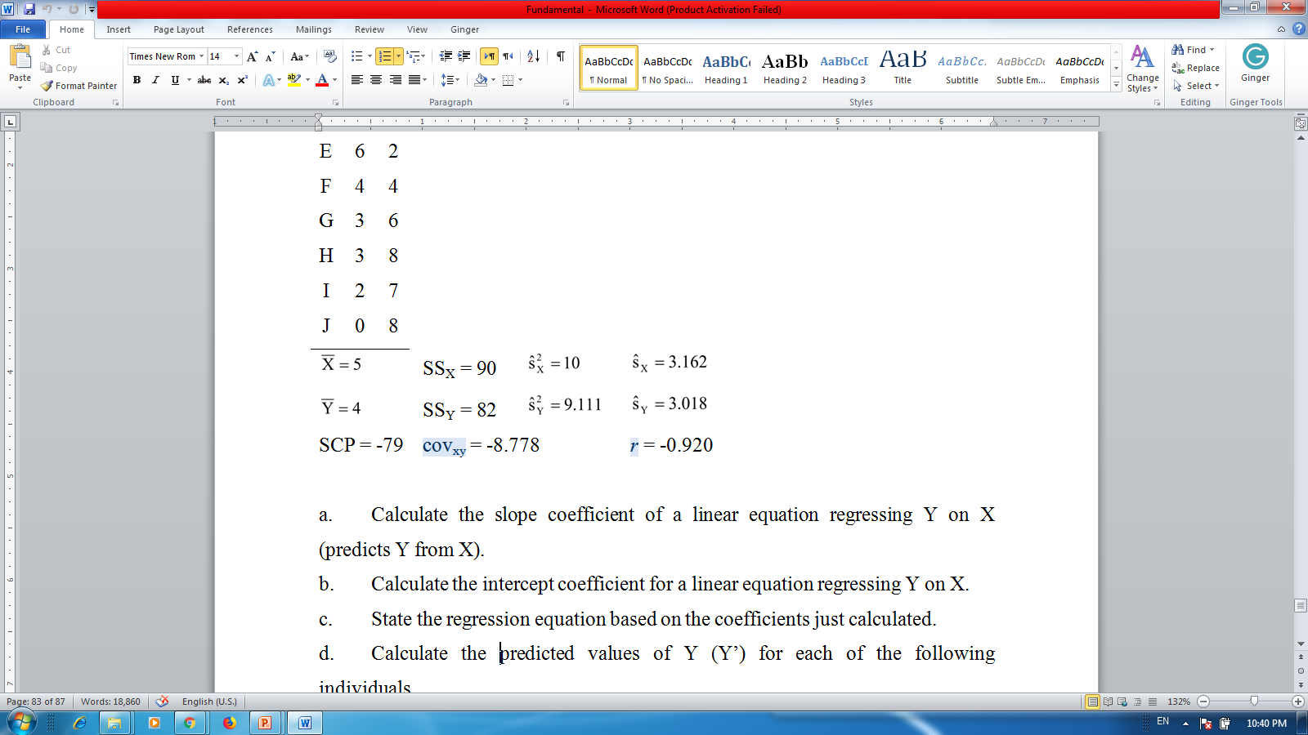

Slide 8
Calculate the slope coefficient of a linear equation regressing Y on X (predicts Y from X).
Calculate the intercept coefficient for a linear equation regressing Y on X.
State the regression equation based on the coefficients just calculated.
Calculate the predicted values of Y (Y’) for each of the following individuals.
Individual B
Individual H
Individual E
Calculate the sum of squares residual and the sum of squares regression (using the computational methods).
Calculate the standard error of the estimate. What does this value tell you about the predicted values of Y?

Slide 9
Use the following to answer the questions below: A researcher collected data on variables X any Y from each of ten subjects. The data for each of these ten subjects are below, as are the summary statistics and Pearson correlation between the two variables:

Slide 10
Individual | X | Y
A | 3 | 7
B | 8 | 9
C | 3 | 3
D | 2 | 8
E | 6 | 8
F | 6 | 9
G | 8 | 6
H | 5 | 4
I | 7 | 2
J | 2 | 4

